Slide 1
Research Computing Update
December 2019

Slide 2
HPC Resources
MI HPC Cluster
In final stages of testing before moving critical HPC servers to news hardware.
The continued delay is partially attributed to PO for the HPC management software support still being in process
PO to renew support for h/w still not finalized, chasing up with Procurement
PI Cluster
There is a large dip in the utilization of the cluster, but likely attributed to faculty teaching/exam commitments.
New HPC Procurement via ANKABUT
Still in process.

Slide 3
Training
“Introduction to Linux” course developed and delivered
Successfully delivered course, which includes students, faculty and researchers.
Course was well received and well attended.
Course is a prerequisite to existing “Intro to HPC”
New instances of course scheduled for early December.
“Introduction to HPC” course delivered
Currently discussing focus of a new Python course

Slide 4
Resource Utilization

Slide 5
MI Cluster core distribution

Slide 6
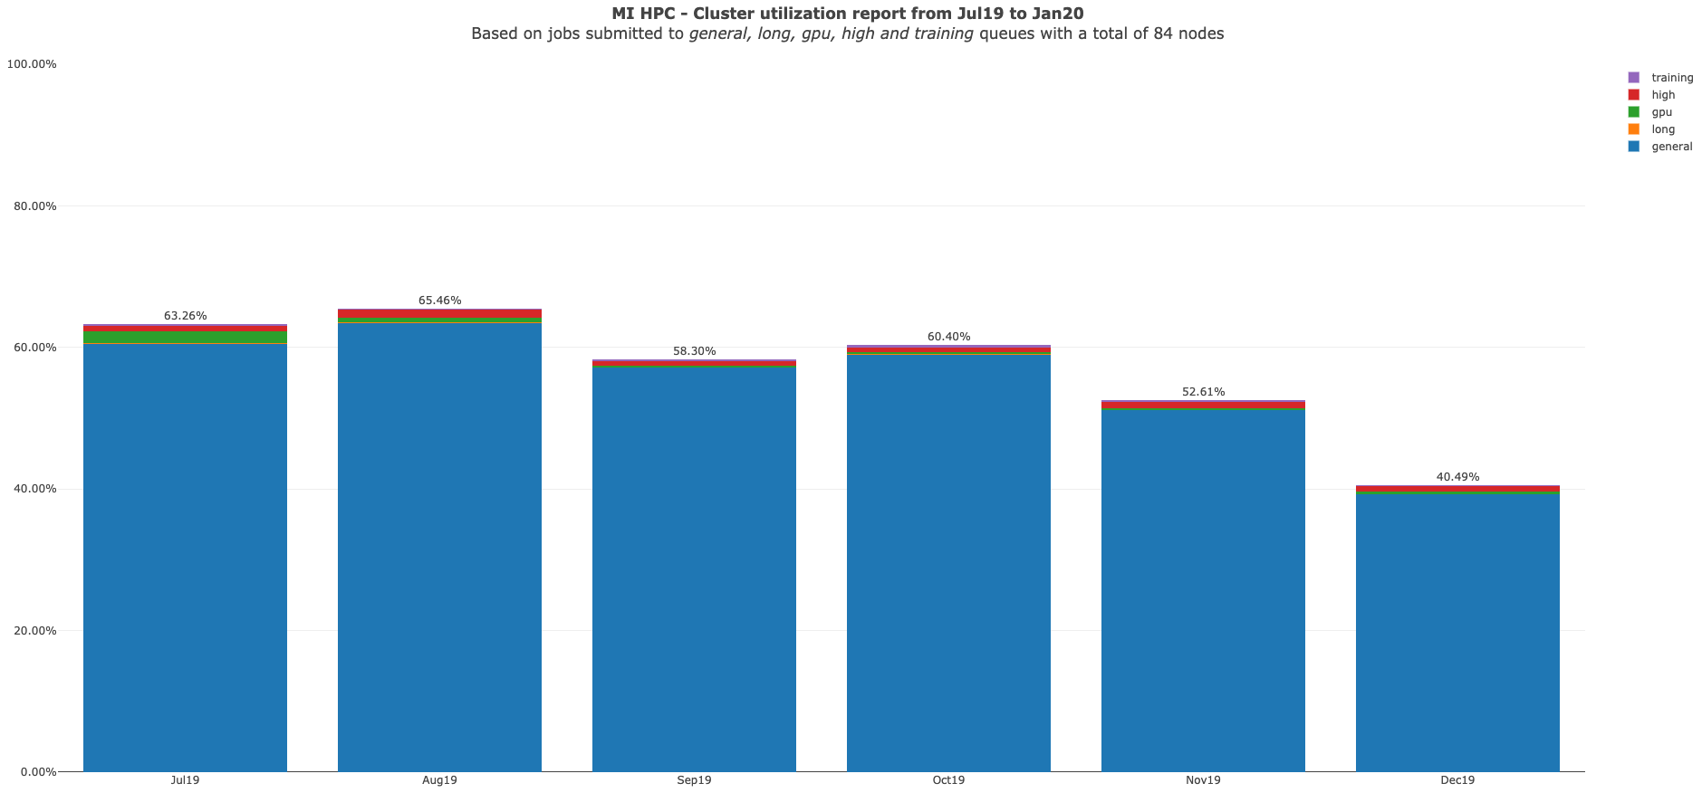

Slide 7
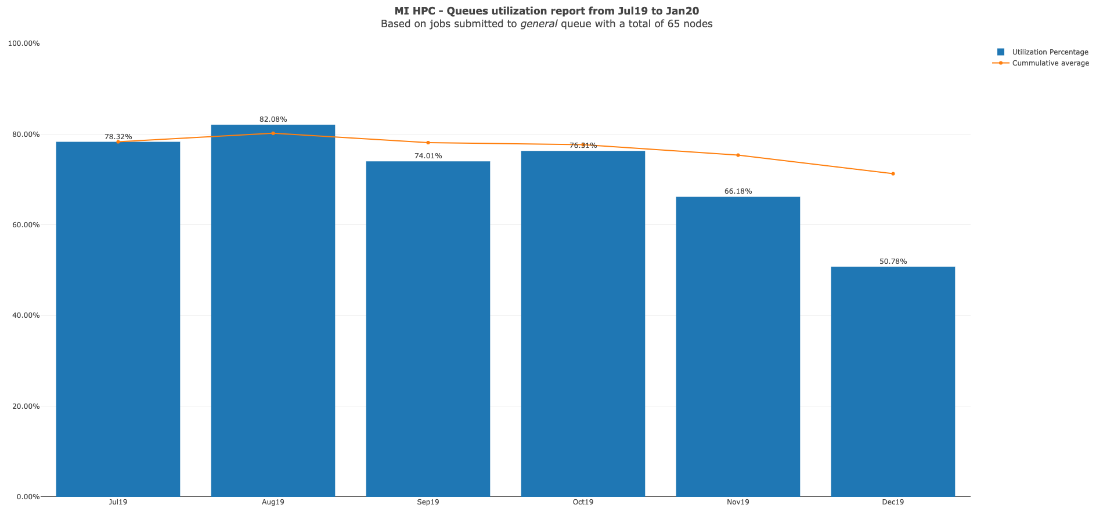

Slide 8
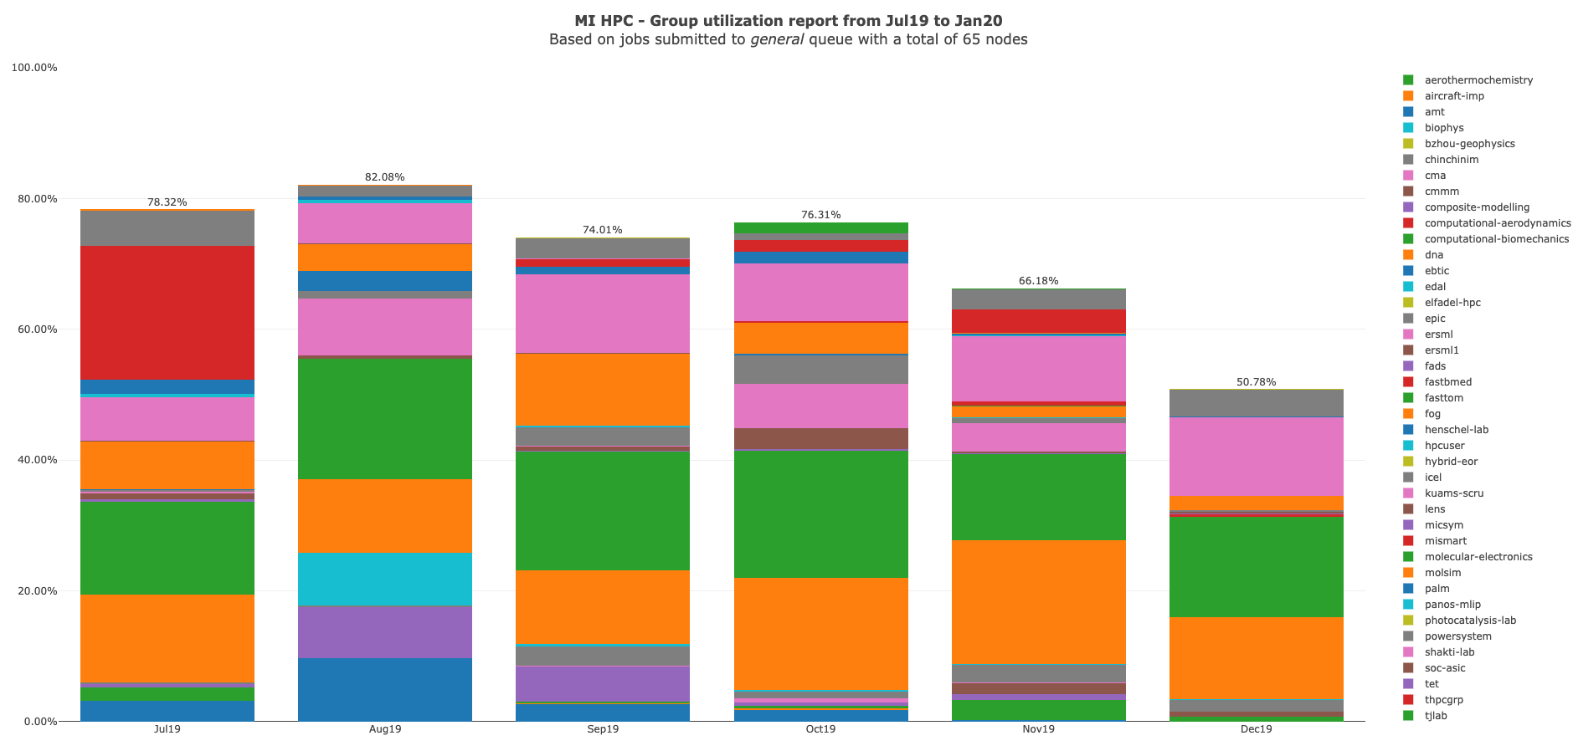

Slide 9
MI HPC Group Utilization for December 2019

Slide 10
PI Cluster core distribution

Slide 11
